Slide 1
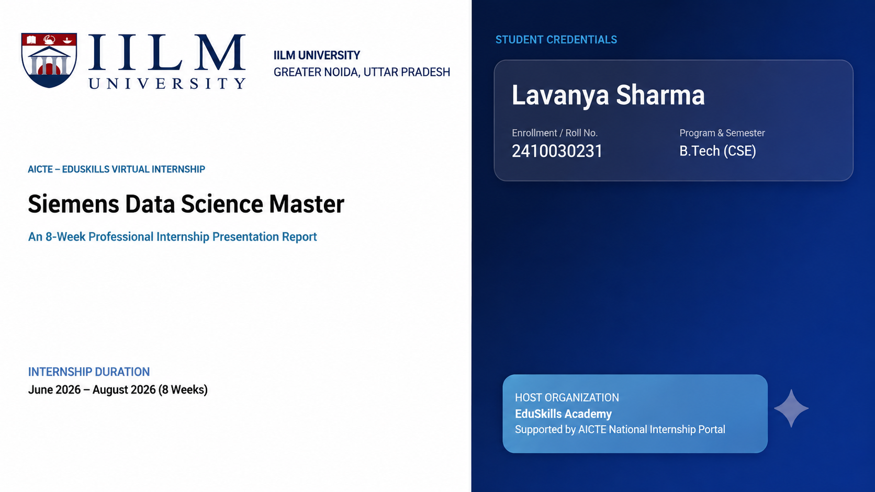

Slide 2

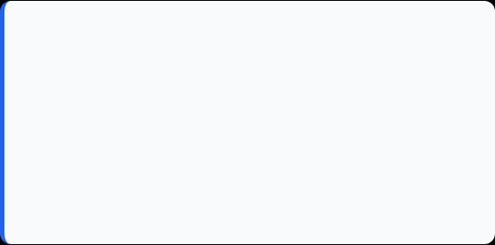
Candidate & Program Overview
Candidate Details
Internship Profile
Student Name: LAVANYA SHARMA
Program Name: AICTE – EduSkills Virtual Internship
Roll Number: 2410030231
Specialization Domain: Siemens Data Science Master
Degree: B.Tech (Computer Science & Engineering)
Duration: 8 Weeks (June 2026 – August 2026)
Academic Batch: 2024-2028
Certificate ID: 45928e8ef68bad7a653e
University: IILM University, Greater Noida, U.P.
Offer Letter Ref: C17Y2026M081492966

Slide 3

Organization Profile: EduSkills Academy
EduSkills Academy is an ISO 9001:2015 and ISO 20000-1:2018 certified organization operating under the vision of "Nation Building Through Skills".
AICTE Collaboration: Operates under the patronage of the AICTE National Internship Portal to empower engineering talent across India.
Industry Alignment: Partners with leading global tech organizations to bridge academia and industry gaps in emerging tech.
Core Focus Domains: Artificial Intelligence, MLOps, Cloud Computing, Cybersecurity, and Enterprise Automation.

Slide 4

Problem Statement & Industry Context
The Industry Challenge
The Solution Scope
Problem: Organizations generate large amounts of data but need effective methods to transform raw data into meaningful insights and Machine Learning solutions.
Industry Need:
Data-driven decision making
Efficient data processing
Reliable Machine Learning models
Automated data preparation
Model deployment
Model monitoring
Enterprise AI platform management

Slide 5








Core Project Objectives
Identify AI/ML business use cases
And
Understand Data Engineering
Perform data transformation
And
Master data preparation
Develop Machine Learning skills
And
Understand advanced ML techniques
Learn model deployment & monitoring
And
Understand RapidMiner AI Hub

Slide 6





Technologies & MLOps Toolchain
Data Layer
ML Layer
Operations Layer
Platform Layer
Data Engineering
Data Transformation
Data Preparation
Machine Learning
Advanced ML
Model Deployment
Model Monitoring
RapidMiner AI Hub
AI Platform Administration

Slide 7
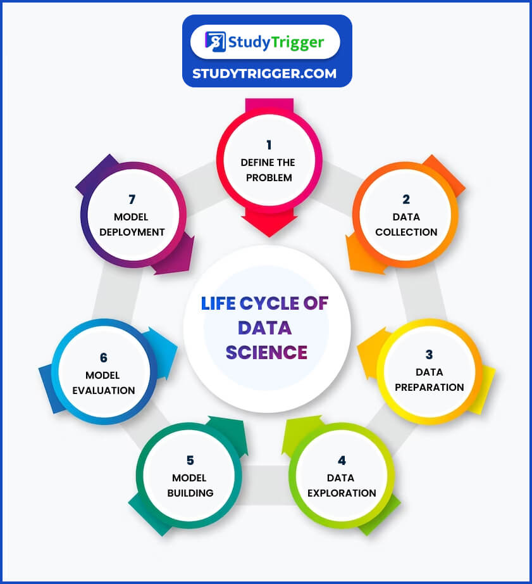
DATA SCIENCE LIFE CYCLE
Business Problem ↓ Data Access ↓ Data Engineering ↓ Data Preparation ↓ Machine Learning ↓ Model Evaluation ↓ Deployment ↓ Monitoring ↓ AI Platform Management

Slide 8
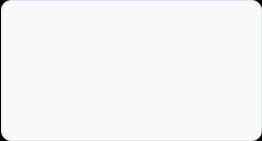
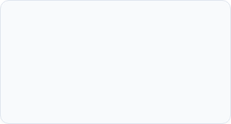
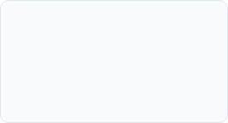
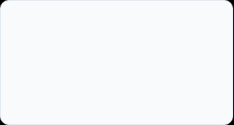
Curriculum Timeline (Weeks 1 to 4)
Week 2
Week 4
Data Engineering
Advanced Data Preparation & Automation
Week 1
Week 3
AI/ML Applications & Use Cases
Machine Learning

Slide 9
Curriculum Timeline (Weeks 5 to 8)
Week 6
Week 8
ML Deployment & Monitoring
Enterprise Platform Operations
Week 5
Week 7
Advanced Machine Learning
RapidMiner AI Hub Administration

Slide 10
Key Projects & Demonstrated Skills
Technical Skills
Data Engineering
Data Preparation
Data Transformation
Machine Learning
Advanced ML concepts
ML Deployment
Model Monitoring
RapidMiner AI Hub
Professional Skills
Problem solving
Technical documentation
Data-driven thinking
Understanding business use cases
Technical presentation

Slide 11

Certification & Official Verification
Verification Metric | Official Record / Credential Details
Internship Title | Data Science Master Virtual Internship
Issuing Organization | EduSkills Academy (ISO 9001:2015 & ISO 20000-1:2018 Certified)
Academic Patronage | AICTE National Internship Portal & EduSkills Foundation
Certificate ID | 45928e8ef68bad7a653e
Offer Letter Ref | C17Y2026M081492966
AICTE Student ID | STU69a6ad6333b1d1772531043

Slide 12
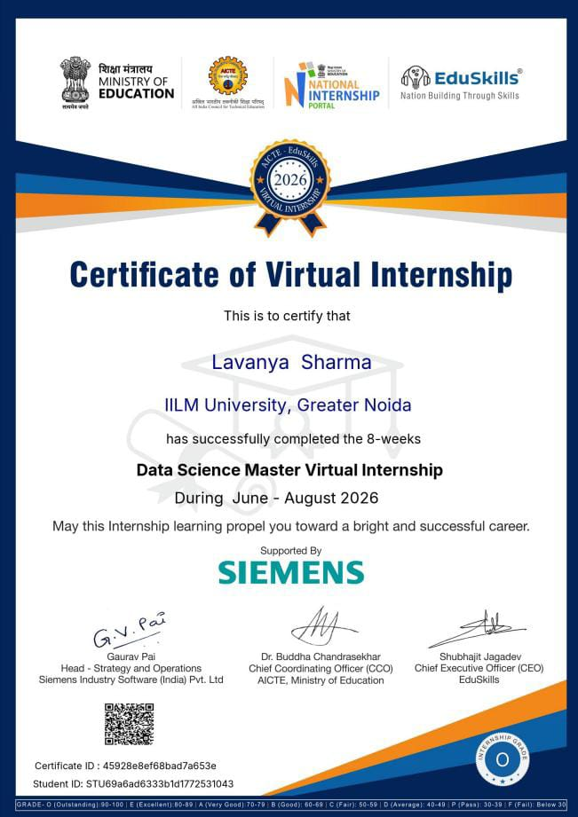
Certification & Official Verification

Slide 13
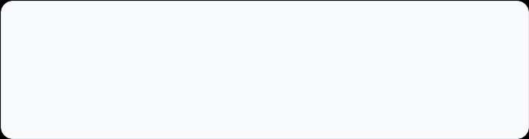
Thank You!
LAVANYA SHARMA
School of Computer Science & Engineering
Roll No:2410030231
IILM University, Greater Noida, U.P.

